Slide 1
CAPSTONE PROJECT – DATA SPARK – Illuminating Insights for Global Electronics
BY KAVITHA THANASEKARAN

Slide 2
DATA SPARK
Data spark is a great project that involved data cleaning of four data sets and merging the necessary data sets for analysis, loading the merged data sets into the MySQL database using SQL queries, writing SQL queries for getting useful insights from the data sets and finally creating the interactive visualization dashboards in Power bi.

Slide 3
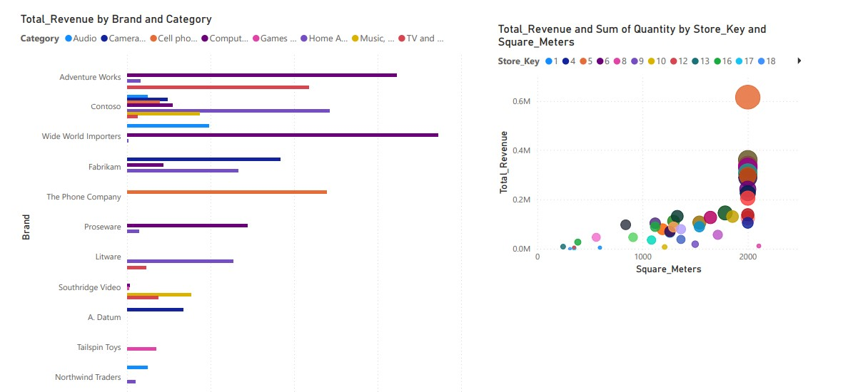

Slide 4





TECHNOLOGIES USED
Python
Pandas
SQL
Power bi

Slide 5
Packages & libraries used
Pandas as pd
mysql.connector
datetime
Os

Slide 6
First step
The first step is the data cleaning process where I managed the missing data and conversion of data types.

Slide 7
Second step
After the pre-processing is done, I have merged the needed datasets and loaded the data in the MySQL database using insert statement.

Slide 8
Third step
This step involved writing SQL queries to get the useful insights of the given data sets.

Slide 9
Final step
Connecting the data with the Power bi and creating interactive visualization dashboards which is easily understandable.
Power bi

Slide 10
THANK YOU

